Slide 1
Work definition: Defining work content

Slide 2
What is Work Content?
Work content is the measured time content of an activity or task determined by using recognised work measurement techniques, at a defined performance level.
Performance is a measure of achieved results, which are meaningful only when related to a valid benchmark or standard. Work content is usually measured at Standard Performance.
So when two people working on tasks with the same work content are achieving slightly different performances, you would start to ask why. What are the causes? Lack of training, no available work, unreliable equipment or information, lack of effort or motivation?

Slide 3
How to calculate Work Content
If someone achieves 1 hour’s work content in 1 hour, that is a 100 performance (60/60 x 100).
If they only achieve 45 minutes’ work content in 1 hour, that is a 75 performance (45/60 x 100).
Clearly time is an essential measure but, to assess performance, it HAS to relate to the work content.

Slide 4
Time Estimation
Time rules all projects.
It’s of paramount importance to everyone involved, from stakeholders to team members.
The clock is always ticking.
The best a project manager can do is develop an accurate time estimate for how long it will take to satisfactorily complete the project.

Slide 5
Time Estimation Matters
A 2018 study by the Project Management Institute (PMI), in its Pulse of the Profession report, stated that poor time estimating is the root cause for 25 percent of failed projects. With those odds, whoever can figure out how to stop the clock is going to be a super project manager.
While it might be impossible to stop time, it is possible to overcome its impending approach as it relates to the project’s end. Looking into the future to determine how much time it will take complete project tasks allows for an estimation. But it’s not sorcery, it’s well-executed project management techniques.
So, what are some of those tips and techniques for better time estimation? They run from simple to the complex. We’ve listed some of the tried and true below. See which work best with your style of project management.

Slide 6
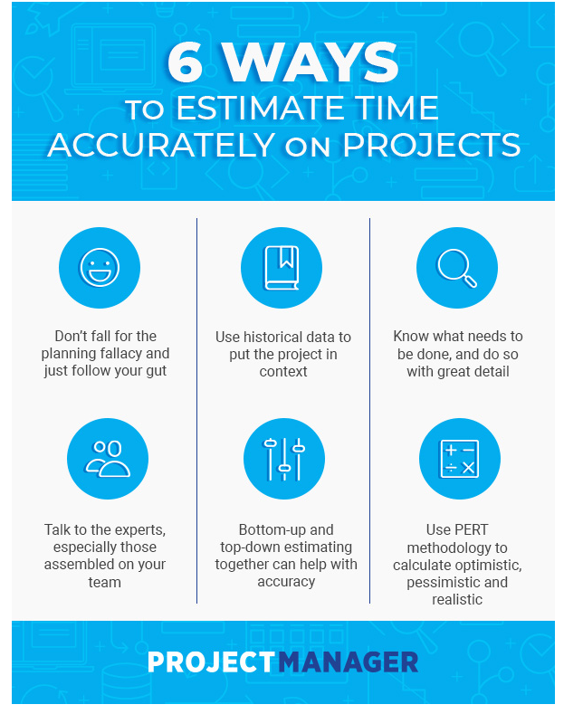
Planning fallacy comes from the work of psychologists Daniel Kahneman and Amos Tversky, who came up with the term in the late 1970s to describe a psychological tendency for people to underestimate the amount of time it will take to complete a task.
People often neglect to take historical data into their calculations and think only of what must be done, which makes estimations ill-informed.

Slide 7
The main lesson to learn from all this psychological profiling is that our gut is a poor estimator of time. Project managers can factor in intuition, but it’s better to have backed up a schedule with hard data. Let’s take a closer look at a couple of these types of hard data.
Historical Data
First is historical data, which is just a fancy way of saying: you’re not the first person to do this. So look back at past examples and see how long they took. More than just anecdotal, historic data is information on past events and circumstances related to a certain subject. Analysis of this data is informative.
Historical data is also broad. It’s a wide net around whatever subject to which it is related. There can be a range of information, here, from press releases to financial reports, log files and project and product documentation.
In order to have a consistent time estimation, historical data is important, but it’s not cheap. Gathering historic data costs money, time and effort. That doesn’t even include analyzation. But even a small amount of historical data is better than none, in that it points to precedent and can lead planning on a path that is more accurate in terms of estimating the time it will take the project to complete.

Slide 8
Know What Needs to Get Done
Historical data only works, however, if a project manager meets beforehand with the stakeholders and has a clear understand of what the goals and the objectives of the project in fact are. This is only the first step towards a full understanding of the project.
There are many tools that can help with identifying the tasks necessary to complete the project successfully and a more accurate schedule can emerge. Just one of those tools is a work breakdown structure template (WBS), which is a way to take project deliverables and break them down into small tasks. This not only makes the work more manageable; it helps with time estimations.
But a project isn’t only executing tasks. There are other, seemingly insignificant, activities that eat up time. Don’t forget to include time it will take to conduct meetings, both with the team and reporting to stakeholders. There’s also communications in general, testing and other activities that occur over the course of the project phases.

Slide 9
Talk to the Experts
You can do much estimating on your own, and even seek historic data to place your project in a larger context, but time estimating should not be done in isolation. Speaking to a person who has worked on similar projects will uncover nuance and details not found in dry data.
Experts are great, but there might be people close by, untapped. We’re speaking about your colleagues. Teams are assembled for expertise and experience. Talk to them, brainstorm, listen to their ideas and concerns.
Chances are team members have done similar projects and have resolved issues that might have sidetracked them in the past. They can give you thoughts about efficient and effective planning, including a better sense of how long everything will take.

Slide 10
Bottom-Up and Top-Down Estimating
Bottom-up estimating is breaking down larger tasks into smaller, more detailed tasks. Then you estimate how much time it will take to complete each task. Estimating time at a granular level also increases accuracy.
Top-down estimating is an analysis in which you first develop an overview of the expected timeline. Then using past projects, experience and historic data as a guide, determine what the time estimate is.
Both time estimate techniques work well together. Compare the results from both, and you’ll have an even more accurate estimation of time needed to complete the project. If the two don’t align, it doesn’t mean one or the other is wrong, just that you must refine your estimate.

Slide 11
PERT
PERT (Program Evaluation and Review Technique) comes from the U.S. Navy, where it was used to estimate time it would take to develop ballistic missiles. It was a complex, massive project, with thousands of contractors involved. Thanks to PERT, the project ended two years earlier than expected.
What PERT does is manage probabilities. It starts with a WBS, breaking down tasks into smaller activities, which is then placed in a Gantt chart. On that Gantt chart, any dependent tasks—tasks that can’t start until another is finished—are linked. Each task is a line on the Gantt chart, starting at one point and ending at the completion.

Slide 12
The Time Estimation Formula
For each of these activities estimate these times: optimistic time (O), the fastest an activity can be completed; most likely time (M), the project manager’s required delivery date; and pessimistic time (P), the longest amount of time given to finish the activity.
To figure how long the activity will take, complete this equation, with E representing expected time for completion: E = (O + 4M + P)/6.
To calculate variance, with V being variance, use this equation: V=[(P – O)/ 6]^2.
After calculating E and V for each activity, add up the Es, and you have an accurate time estimate for project completion.

Slide 13
Work Breakdown Structure
The WBS is a product-oriented hierarchy of the scope of work embodied in a numbering structure that provides a system for organizing the scope in a logical manner.
The WBS is prepared in conjunction with the scope of work, and it should be developed to the level of detail where responsibility for work performance is assigned.
Responsibility for each element of a WBS is then established.
The most popular portrayal of a project WBS is in graphic form, similar to an organization chart.
This WBS chart displays project elements and tasks in levels and boxes, representing smaller parts of the project.
The WBS is a mandatory requirement for the PM plan.

Slide 14
The WBS facilitates the following:
Understanding of the work
Planning of all work Identifying end products and deliverables
Defining work in successively greater detail Relating end items to objectives
Assigning responsibility for all work Estimating costs and schedules
Planning and allocating resources Integration of scope, schedule, and cost Monitoring cost, schedule, and technical performance
Summarizing information for management and reporting
Providing traceability to lower levels of detail Controlling changes.

Slide 15
Cost Estimates, Budgets, and Financial Management
Every PM plan includes a cost estimate, a budget, or both.
The cost estimate is normally in table format and includes a summary of costs for each major task or element of the project.
Financial management includes systems and procedures for establishing budgets, for reporting financial information, for controlling costs, and for managing cash flow.

Slide 16
Cost Estimates
The most straightforward method of estimating costs is to use the WBS and schedule.
Each element of the WBS or each activity in the schedule or network can have a cost associated with it.
Therefore, the approach is to go down the list of activities or WBS elements and estimate the cost for each one.
Costs are estimated by identifying the resources needed for each activity, in what quantities, and at what price.
The pricing of the resources depends on the timing, so normally a cost estimate is not finalized until the project activities have been scheduled.

Slide 17
Budgets
Budgets are cost estimates that have been approved by management and formally established for cost control.
Actual costs are compared to budgets as the project is completed, to identify variances and potential problems and to provide information on what the costs will be.
The budgeting process includes extensive reviews and revisions of the cost estimates, to arrive at the final budget figures.

Slide 18
Financial Management
The requirements, systems, procedures, and responsibilities for project financial planning, management, and control are addressed in this section.
Financial control includes cash flow management as well as conventional cost control (standard cost accounting, cost performance reporting, and cost productivity assessment).
Cash flow management involves traditional income and expenditure reporting and analysis.
On most projects, funding and funds management are critical, representing the timing at which resources can be scheduled and work accomplished.
Cash flow planning and reporting procedures and responsibilities are established in the PM plan, ensuring that funds are available as needed on the project.

Slide 19
Risk Analysis and Contingency Plan
Projects need to be assessed to identify areas containing high degrees of risk—for instance, those activities associated with new research, technical developments, or other tasks that have never been done before.
Risk may also be associated with the external environment, such as economic conditions, political uncertainties, weather, geography, public opinion, or labor-related factors.
This section of the PM plan provides an opportunity to consider project risks and to develop contingency plans. T
Topics suggested for this section are risk identification, risk analysis, risk minimization plans, and contingency plans and reserves.

Slide 20
Risk Identification
The WBS is used to identify risks associated with specific elements of the project. Each WBS element is assessed for risk.
Risk is higher when new or unproven technologies are required. Greater uncertainty is also expected when all aspects of a task or project element are not yet planned in detail.
Finally, risk is generally higher during the early stages of a project or task than when nearing completion.

Slide 21
Risk Analysis
Risk analysis includes a detailed discussion of the risk, including both internal and external factors.
An impact table is prepared with factors assigned based on technology status, planning status, and design/project status.
Finally, the potential cost and schedule impact is assessed.
The impact table includes a worst-case cost estimate for each of the project elements included.

Slide 22
Risk Minimization Plans
Once the risks to the project have been identified and assessed, strategies are needed to minimize them: technology development, modeling, demonstrations, peer reviews, replanning, changes in project logic, reorganization of project participants, contractual changes, etc.
The idea is to adapt a proactive, planning-based approach to risk assessment and to minimize project risks through specific actions.

Slide 23
Contingency Plans and Reserves
Changes in technical performance or schedules require a reevaluation of contingency reserves. Risk analysis can be performed in conjunction with cost estimating when estimates of contingency reserves are calculated.
Cost estimates may be inaccurate for various reasons, such as engineering errors or oversights, schedule changes, cost or rate changes, external factors, construction or implementation problems, or estimating errors.
The amount of reserves depends on the funds available, overall riskiness of the project, and the management approach.

